Slide 1


Slide 2
When the Church celebrates the liturgy of Advent each year, she makes present the ancient expectancy of the Messiah, for, by sharing in the long preparation for the Saviour's first coming, the faithful renew their ardent desire for His Second Coming.

Slide 3
HOPE

Slide 4
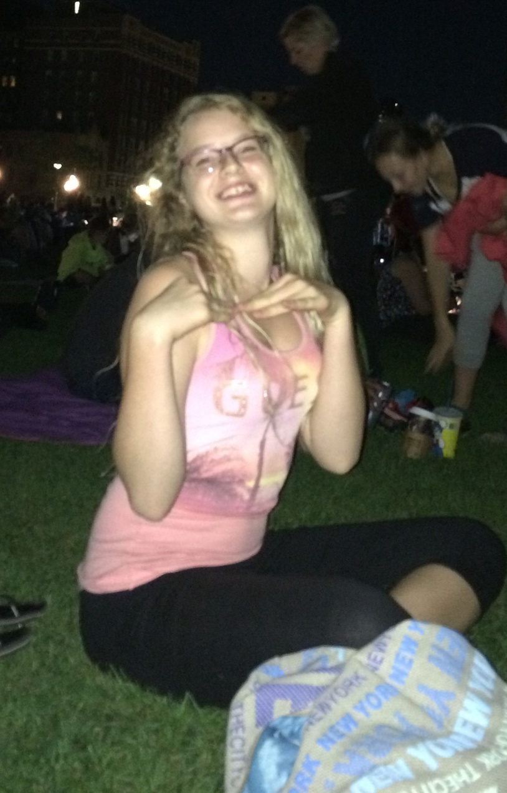

Slide 5


Slide 6


Slide 7


Slide 8


Slide 9
Luke 1:37-38
For no word from God will ever fail.”
³⁸ “I am the Lord’s servant,” Mary answered. “May your word to me be fulfilled.” Then the angel left her.

Slide 10
Hebrews 6:16-20
People swear by someone greater than themselves, and the oath confirms what is said and puts an end to all argument. ¹⁷ Because God wanted to make the unchanging nature of his purpose very clear to the heirs of what was promised, he confirmed it with an oath. ¹⁸ God did this so that, by two unchangeable things in which it is impossible for God to lie, we who have fled to take hold of the hope set before us may be greatly encouraged. ¹⁹ We have this hope as an anchor for the soul, firm and secure. It enters the inner sanctuary behind the curtain, ²⁰ where our forerunner, Jesus, has entered on our behalf. He has become a high priest forever, in the order of Melchizedek.

Slide 11


Slide 12
JESUS CAME ONCE AND IS COMING AGAIN
DANGEROUS HOPE
LIVE AND LOVE LIKE JESUS

